Slide 1

Clinical Copilot: AI-Assisted Point-of-Care Summarization
From raw records to actionable 3-step plans
Author | Date

Slide 2

Problem Context
Data overload
Fragmented patient history
Decision latency
Risk of missed critical factors

Slide 3

Clinical Pain Points
Too much irrelevant EHR data
Time pressure
Lack of structured summarization
Cognitive load

Slide 4


Core Challenge (Reframed)
Deliver complaint-specific, evidence-supported options in seconds—not generic summaries.
Extract only complaint-relevant facts
Produce 3 safe options

Slide 5
Solution Overview
Single-file Streamlit app, FHIR or Excel ingestion, relevance filter → structured LLM output (Problem / Factors / 3-Step Plan), selection + PDF + visit logging.
01
02
FHIR/Excel Ingestion
Relevance Filter
Seamlessly integrate patient data.
Focus on critical information.
03
04
Structured LLM Output
Selection + PDF + Visit Logging
Problem, Factors, 3-Step Plan.
Actionable and recordable outcomes.

Slide 6





Architecture Diagram
Data
Intelligence
Governance
Action

Slide 7
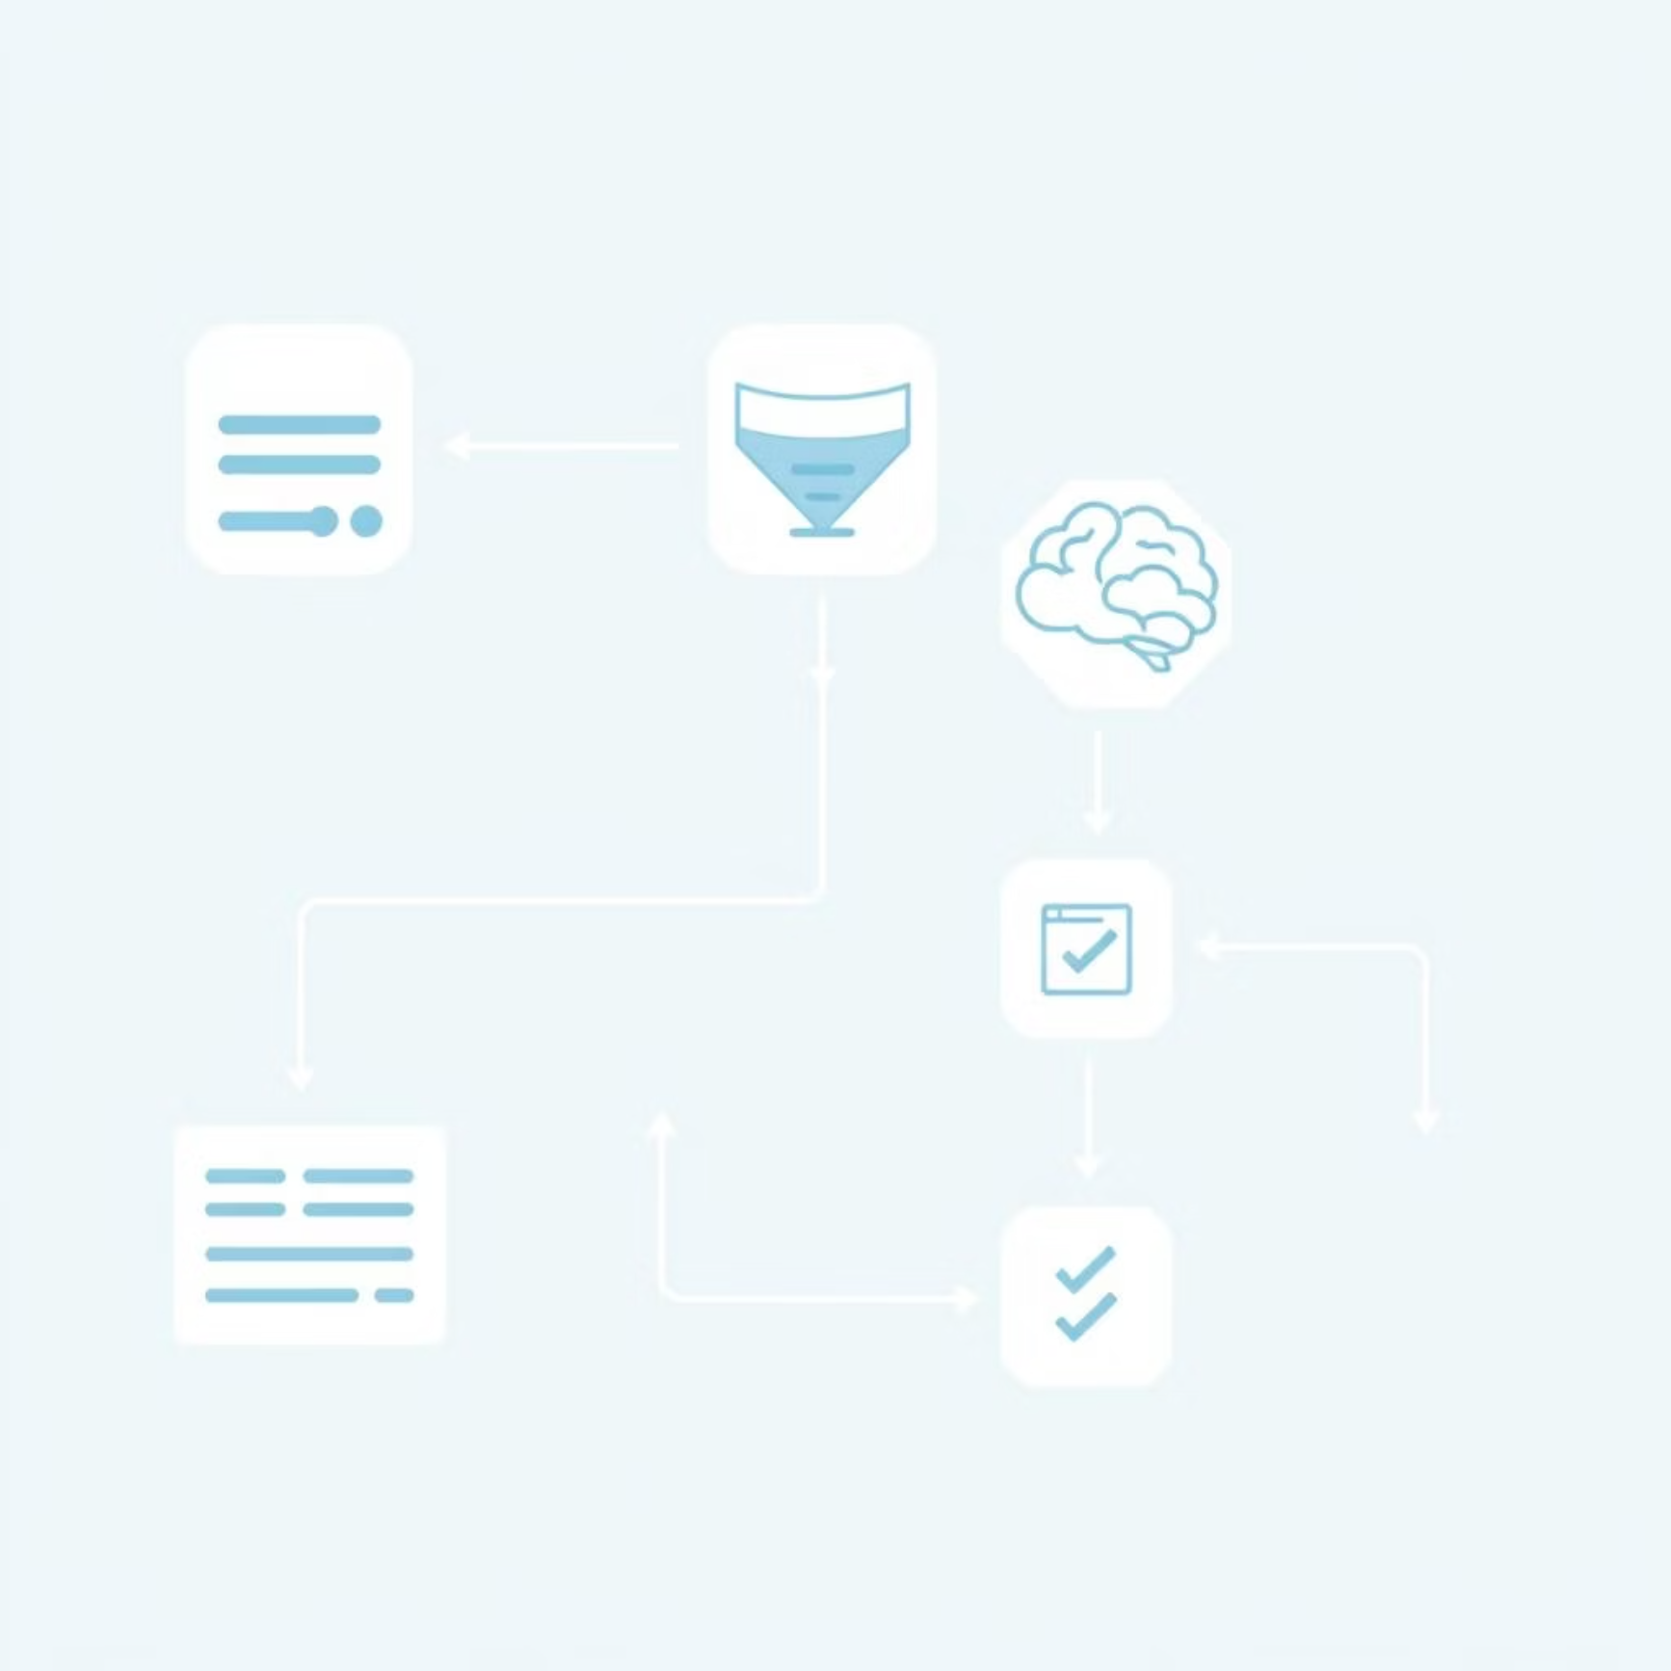
Data Flow & Components
Patient query → fetch
Normalize → relevance scoring
Prompt → model
Parsed output
Key Components
FHIR fetch
Excel mapping
Heuristic filter (keywords)
Deterministic parser
Session state

Slide 8
Relevance Filtering
Musculoskeletal example, reduces noise & token cost, highlights decision-impacting factors (implants, anticoagulants, metabolic risks).
Reduces Noise
Lowers Token Cost
Highlights Key Factors
Focuses on critical information.
Efficient LLM processing.
Decision-impacting elements like implants, anticoagulants, metabolic risks.

Slide 9

Prompt Contract
Strict template (≤120 words), sections enforced, deterministic parsing (Problem, Factors, 3 steps) → reliability & low hallucination surface.
Problem: [Patient's primary complaint]Factors: [Key medical history, relevant findings]Plan:1. [Step 1]2. [Step 2]3. [Step 3]
Ensures reliability and minimizes AI hallucination.

Slide 10

Security & Privacy
No keys in repo, env secrets
Optional local XLSX
No PHI recommended in demo
Future: auth + audit
https://github.com/KrithikVishal/Clinical-Copilot-AI

